Slide 1

The Business Environment (BENV) -
Revision Session

Slide 2

Topics
What is tested from ITBK and POBC in this exam?
Types of Businesses
Corporate Social Responsibility (CSR)
The Fundamental Ethical Principles and Threats

Slide 3
What is tested - ITBK
Understand how to set up bookkeeping systems (Financial Documents, Day Books, Entries in the different Ledgers, Manual vs Digital)
Process customer transactions (Recording Sales, Returns, Receipts, Discounts Allowed etc)
Process supplier transactions (Recording Purchases, Returns, Payments, Discounts Received etc)

Slide 4
What is tested - POBC
Use control accounts (RLCA, PLCA, Identifying differences for balances between ledger and control account)
Reconcile a bank statement with the cash book
Use the journal (Correction of Errors)

Slide 5
Types of Businesses
The 4 main types of businesses covered in this unit are:
Sole Trader (Owned by one person. Unlimited liability. Full control. All Profits)
Partnerships (including LLP’s) (Standard partnership is same as sole trader with a minimum of 2 people. LLP is limited liability and financial statements must be filed with companies house)
Limited Companies (Private and Public) (Separate legal entity. Owned by shareholders, ran by directors. Limited Liability. Shareholder entitled to profits via dividends. More admin and corporation tax. Public is same but shares can be sold to the public via stock exchange.
Not-For-Profit Organisations (all profits are put back into the business. Public sector = Govt owned such as NHS. Private sector = charities etc)

Slide 6
Types of Businesses
Sophie currently runs a small cake business from home as a sole trader. The business has grown quickly, and she is worried about the risks if the business were to get into debt. Her friend Daniel has suggested forming a private limited company instead.
Sophie is also considering going into business with her sister, Mia, but they are unsure whether to form a partnership or a limited company.
1 – What is meant by unlimited liability? The owner is responsible for the business debts and personal assets could be used to repay debts.
2 – Identify one advantage and one disadvantage of being a sole trader. Ad – keep all profits, full control, easier to set up, less admin. Disad – unlimited liability, harder to raise finance.
3 – Explain two advantages of Sophie forming a private limited company. Limited Liability instead of unlimited liability, separate legal entity, easier to raise funds (more people).
4 – State one key difference between a partnership and a private limited company. Unlimited liability or separate legal entity.

Slide 7
CSR – Sustainability
Sustainability acts in three areas which are listed below. Match up each concept with the descriptions given.
Concept
Economic
Environmental
Social
Description
Making a positive impact on reducing inequality and provide better opportunities for people.
Ensuring the business operates successfully and maintains a profit to avoid unemployment and negative impacts on the local community.
Minimising the impact a business has on pollution, energy usage, recycling and it’s carbon footprint.

Slide 8
CSR – Sustainability
BrightTech Ltd is a company that manufactures electronic devices. Recently, the business has received criticism about the environmental impact and employment practices caused by it’s operations. They are considering the following actions to help manage this situation:
Installing energy efficient machinery in the factory
Introducing a staff training and development program.
Ensuring suppliers meet fair labour standards
Donating a percentage of annual profits to local community projects.
Explain how each of the following CSR concepts are affected. (9 marks)
Economic – Energy efficient machinery may reduce long term costs. CSR can improve reputation and sales. Staff training can improve productivity.
Environmental – Energy efficient machinery reduces energy consumption (electricity). Lower carbon emissions as less electricity is used so less reliance on fossil fuels. Modern machinery likely to use raw materials more efficiently leading to less scrap or waste.
Social – Staff training improves employee wellbeing and career prospects. Donations support the local community. Fair labour standards protect workers in the supply chain.

Slide 9
The Fundamental Ethical Principles
There are five ethical principles that AAT have identified, and all members should follow these. Which of the descriptions provided below align with the correct ethical principle.
Description | Ethical Principle
Only carrying out work which you have the appropriate level of experience and qualifications to do and ensuring this is completed to the highest possible standard. | Professional Competence and Due Care
Sensitive or personal data is not disclosed to unauthorised individuals. It is not accessed by people or other organisations who do not have the right to see it. | Confidentiality
Acting openly and honestly in all business transactions and whilst at work. | Integrity
The accountancy profession has high expectations of the ways in which accountants should conduct themselves. Anything which brings the reputation of accountancy as a profession into disrepute is deemed to be unprofessional behaviour. | Professional Behaviour
Business decisions should not be influenced or biased by personal influences. Decisions should be impartial and based wherever possible on factual evidence rather than personal prejudice. | Objectivity

Slide 10
Threats
There are also five threats to the five ethical principles. Which of the descriptions provided below align with the correct threat.
Description | Threat
Occurs when the accountant knows that they (or someone close to them) will benefit by making a particular decision. | Self Interest
Occurs when the accountant is close to someone affected by their decisions. This could be caused by family or personal relationships, friendships or close business relationships. | Familiarity
The accountant may not be prepared to devote sufficient time and care to check their own work thoroughly. If they do find errors, they may be tempted not to disclose them. | Self Review
When the accountant promotes a position or opinion to the point that objectivity may be compromised. No preferential treatment should be given to specific stakeholders. | Advocacy
The accountant fears they will be harmed in some way by a course of action due to pressure from someone else. These threats could come from physical or emotional threats, blackmail, or the threat of losing their job. | Intimidation

Slide 11
Scenario 1
You work as an Accounts Assistant at GreenTech Supplies Ltd, a company that sells environmentally
friendly office equipment. You report to the Finance Manager, but you receive the following email
directly from the Finance Director.
Write a response to this email and include the following:
Identify the ethical principles at risk
Identify the threats to the ethical principles
Explain why these are issues
Suggest an appropriate course of action
From: J Carter, Finance Director To: Accounts Assistant Subject: URGENT – Year-End Figures Hi, We are very close to securing a large bank loan which will allow us to expand next year. The bank is reviewing our year-end financial statements tomorrow. I’ve looked at the draft figures and profits are slightly lower than expected. I need you to delay recording the recent supplier invoices (£18,000) until next month. This will improve our profit position for the bank review. Also, one of our biggest customers is my sister’s company. We haven’t yet received payment from her, but please don’t include her overdue balance in the aged receivables report being sent to the bank. I know she’ll pay soon. As you know, bonuses this year depend on the business hitting its profit targets. If this loan goes through, it will benefit everyone – including you. There’s no need to discuss this with anyone else. I trust you to handle it discreetly. Thanks, James Carter

Slide 12
Scenario 1
From: Accounts Assistant To: J Carter, Finance Director Subject: URGENT – Year-End Figures Hi James, Thank you for your email regarding the year-end figures. Having considered your request, I am concerned that delaying the recording of the supplier invoices and excluding the overdue balance from the aged receivables report would not comply with professional ethical standards. The request to postpone recording the £18,000 supplier invoices would affect the accuracy of the financial statements. This raises concerns regarding the principle of integrity, as financial information must be presented honestly and transparently. It also affects professional competence and due care, as I have a responsibility to ensure financial records are complete and accurate. Removing the overdue balance relating to your sister’s company creates a potential conflict of interest. This impacts the principle of objectivity, as personal relationships should not influence professional judgement. I am also concerned that presenting financial information to the bank that does not fully reflect the company’s true position could breach the principle of professional behaviour, as it may mislead external stakeholders. There are several ethical threats present in this situation which include: Self Interest – staff bonuses are linked to profit targets and loan approval Familiarity – the relationship with your sister’s company Advocacy – information being adjusted to support securing the bank loan Intimidation – due to the urgency and request for discretion Self Review – if adjustments are later reviewed internally Given these concerns, I would not feel comfortable making the requested changes. I believe the appropriate cause of action would be to ensure all transactions are recorded accurately and to discuss this matter with the Finance Manager in line with company policy. Kind regards, Accounts Assistant

Slide 13
Scenario 2
You work as an Accounts Assitant at Riverstone Training Ltd. As part of your role, you have access to the company’s customer database, which includes addresses, contact numbers and payment information. You receive the following email from the Commercial Director.
Write a response to this email and include the following:
Identify the ethical principles at risk
Identify the threats to the ethical principles
Explain why these are issues
Suggest an appropriate course of action
From: M Benson, Sales Director To: Accounts Assistant Subject: URGENT – Customer List Hi, My friend has just started a new marketing business and is looking for potential clients. I’d like you to download our full customer list (including contact details) and send it to my personal email address so I can forward it onto him. This doesn’t need to be recorded anywhere as it’s just to help him get started. It won’t cause the business any harm. Also, I’ve noticed some customers have outstanding balances over 90 days. Before I present the report at tomorrow’s board meeting, please amend the aged receivables report to show those balances at 30 days outstanding instead. It will make the credit control position look much stronger. We need to show the business is a positive light as management bonuses are being reviewed next month. I need this done before the end of the day. I’d prefer you not raise this with anyone else! Thanks, Mel Benson

Slide 14
Scenario 2
From: Accounts Assistant To: M Benson, Sales Director Subject: URGENT – Customer List Dear Mel, Thank you for your email. I am concerned about the requests outlined below, as they raise several ethical issues. Providing the full customer list to an external party without authorisation would breach the principle of Confidentiality. Customer information is sensitive and must be protected in line with company policies and data protection regulations. Sharing this information could put the business at legal and reputational risk. I am also concerned about the request to amend the aged receivables report to show balances as at 30 days outstanding. This would not present an accurate account of the businesses financial position and would therefore breach the principle of integrity, as financial information must be honest and complete. In addition, altering reports without proper justification would not demonstrate Professional Competence and Due Care. I have a responsibility to ensure that financial information is accurate and prepared in accordance with company procedures. There are also ethical threats present in this situation. A self interest threat exists because management bonuses are linked to business performance. There is also an intimidation threat, as the request is urgent and includes a suggestion to not raise this matter with anyone else. For these reasons, I would not feel comfortable carrying out the requested actions. I believe the appropriate course of action would be to maintain accurate records and follow company data protection and report procedures. Please let me know how you would like to proceed within company guidelines. Kind regards, Accounts Assistant

Slide 15
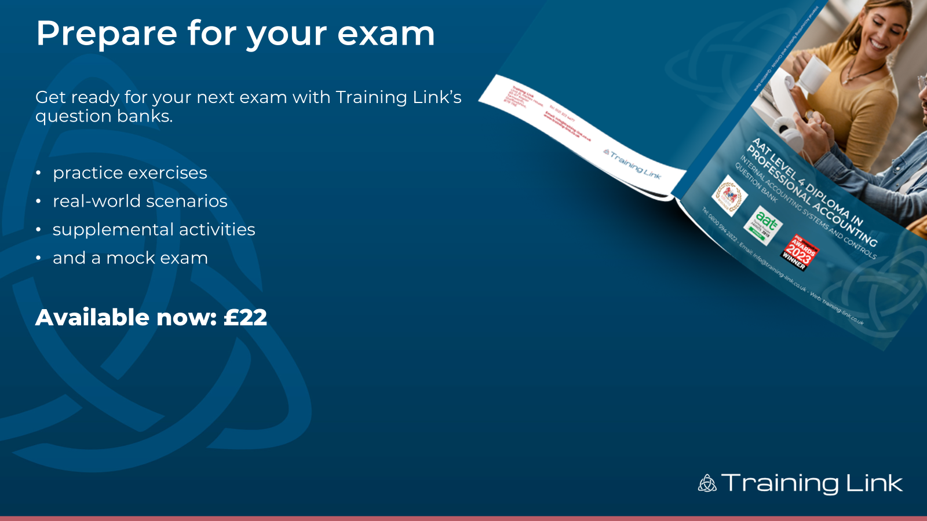

Prepare for your exam
Get ready for your next exam with Training Link’s question banks.
practice exercises
real-world scenarios
supplemental activities
and a mock exam
Available now: £22

Slide 16

Prepare for your exam
Get ready for your next exam with Training Link’s question banks.
practice exercises
real-world scenarios
supplemental activities
and a mock exam
Available now: £22

